Slide 1
Space Complexity
Space complexity refers to the total amount of memory space used by an algorithm.
The best algorithm should have a low level of space complexity. The less space required, the faster it executes.
Similar to time complexity, space complexity is often expressed asymptotically in big O notation like O(n), O(nlogn), etc. where n is the input size.

Slide 2
Space Complexity
For any algorithm, memory is required for the following purposes:
to store program instructions
to store constant values
to store variable values
for few other things like function calls, jumping statements, etc.

Slide 3
Auxiliary space
Auxiliary space is the temporary space (excluding the input size) allocated by the algorithm to solve the problem.
Like overhead for instructions, function calls, return, etc.
Auxiliary space + space use by input values = Space Complexity
In most cases, we only calculate the auxiliary space to compare algorithms.

Slide 4
Example
An integer occupies 4 bytes of memory. As a result, the number of allocated bytes would be the space complexity.
An example of computing the multiplication of array elements:
function add(n1, n2){
sum = n1 + n2;
return sum;
}
n1,n2: 2*4 bytes= 8 bytes
sum: 4 bytes
Aux: 4 bytes
Overall: 16 bytes
Space complexity: O(1)

Slide 5
Example
Comparing the following algorithms (time and space complexity):
public int findSum(int n){
return n*(n+1)/2;
}
public int findSum(int n){
int sum=0;
for(int i=1; i<=n; i++){
sum=sum + i;} return sum;
}

Slide 6
Methods for Calculating Space Complexity
In most cases, for comparing two algorithms we only calculate the auxiliary space to find the algorithms’ differences in space complexity ignoring the input size.
We want to track how much space is taken, given a particular input size.

Slide 7
Auxiliary Space in Algorithms
While many iterative algorithms can achieve 𝑂(1) auxiliary space, certain problems require extra storage due to the nature of their operations.
Recursive algorithms, dynamic programming with large tables, graph traversal, and specific divide-and-conquer strategies are all examples of cases where auxiliary space is not 𝑂(1).

Slide 8
In-Place Algorithms
The in-place algorithms are those that don’t need any auxiliary data structure in order to transform the input data.
The algorithm doesn’t use extra space for input manipulation. It practically overrides the input with the output.

Slide 9
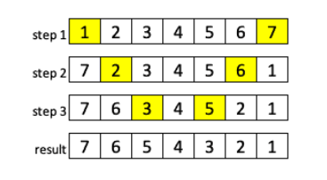
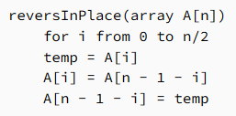
Example of in-place Algorithm
The problem is: Reverse an input array.
In the end, we don’t need the original array, only the reversed one.
We can overwrite the input instead of moving its values to the completely new array.
To do that, we’ll only need one additional variable to temporarily store the values that we’re currently working with.

Slide 10
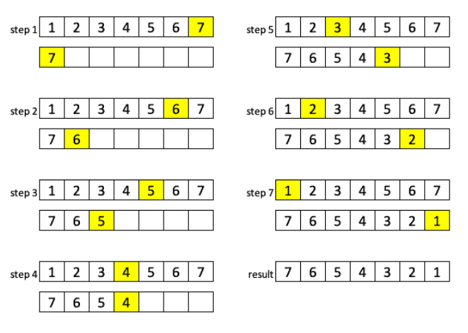
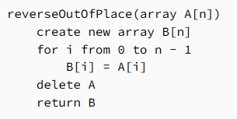
Example of Out-of-place Algorithm
We can create a new array of the same size, copy the values from the original one in the corresponding order and then delete the original array.
It’s not efficient. We have O(n) extra space required since we have two arrays to manipulate with. Besides that, creating and removing a new array is usually a slow operation.

Slide 11
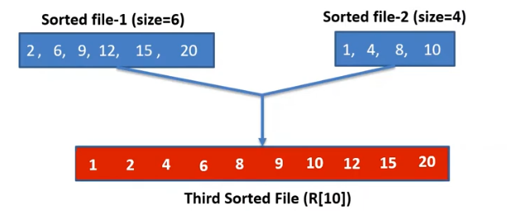
Merge Sort Space Complexity
Merge sort algorithm is not in-place algorithm
The algorithm must create N elements in memory.
All elements are copied into an auxiliary array of size N, where N is the number of elements present in the unsorted array.
Space complexity is O(N)

